Slide 1


Bonrix.biz
AI-Powered Tools for the Future
Transforming Workflow and Unlocking New Possibilities with Intelligent Solutions

Slide 2

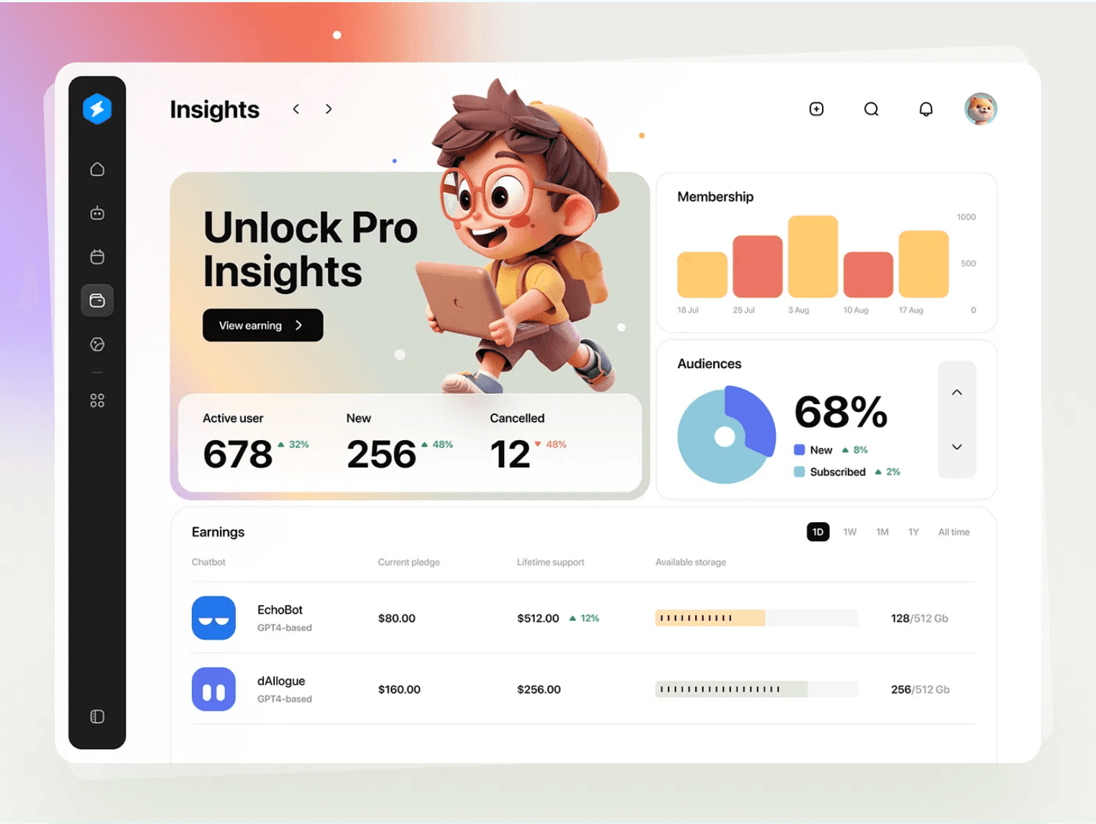
The AI Advantage
Transforming Business Workflows
Bonrix provides cutting-edge artificial intelligence to solve real-world business challenges where traditional programming falls short.
→
Leveraging
AI/ML applications
for practical business solutions
→
Focus on
transforming everyday tasks
with intelligent products
→
Unlocking
new possibilities
for efficiency and customer engagement

Slide 3




Core AI Philosophy
Intelligence Built on Three Pillars
Deep Learning
Continuous Learning
Privacy Focused
Our neural networks process data with human-like intuition, recognizing patterns and making real-time decisions with remarkable accuracy.
Our systems evolve with your needs, improving performance through reinforcement learning and user feedback mechanisms.
Federated learning models ensure your data never leaves your devices while benefiting from collective intelligence.

Slide 4

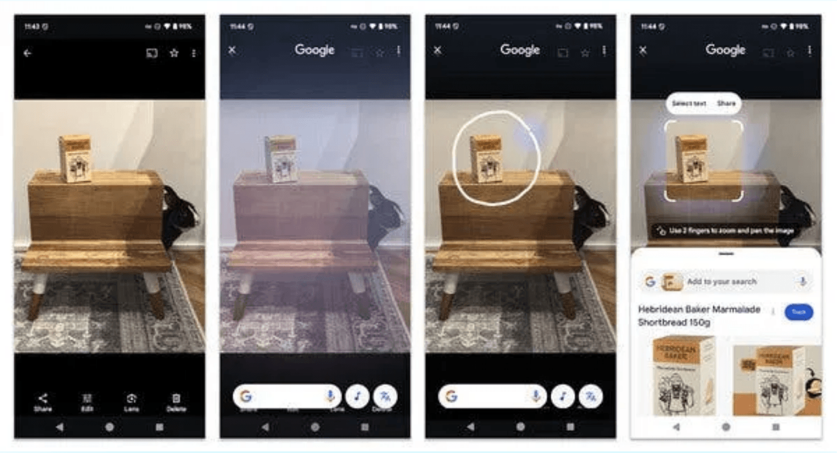
Revolutionizing E-commerce
Image-to-Image Catalog Search
A breakthrough AI-powered solution for e-commerce and retail, transforming how customers discover and shop for products.
Key Features & Benefits
✦
Image-to-Image Search:
Find products visually, eliminating keyword limitations
✦
AI-Driven Discovery:
Intelligent product recommendations and catalog search
✦
Virtual Try-On:
Enhance customer experience and reduce returns
✦
Smart Prompt Search:
Advanced search capabilities for complex queries

Slide 5

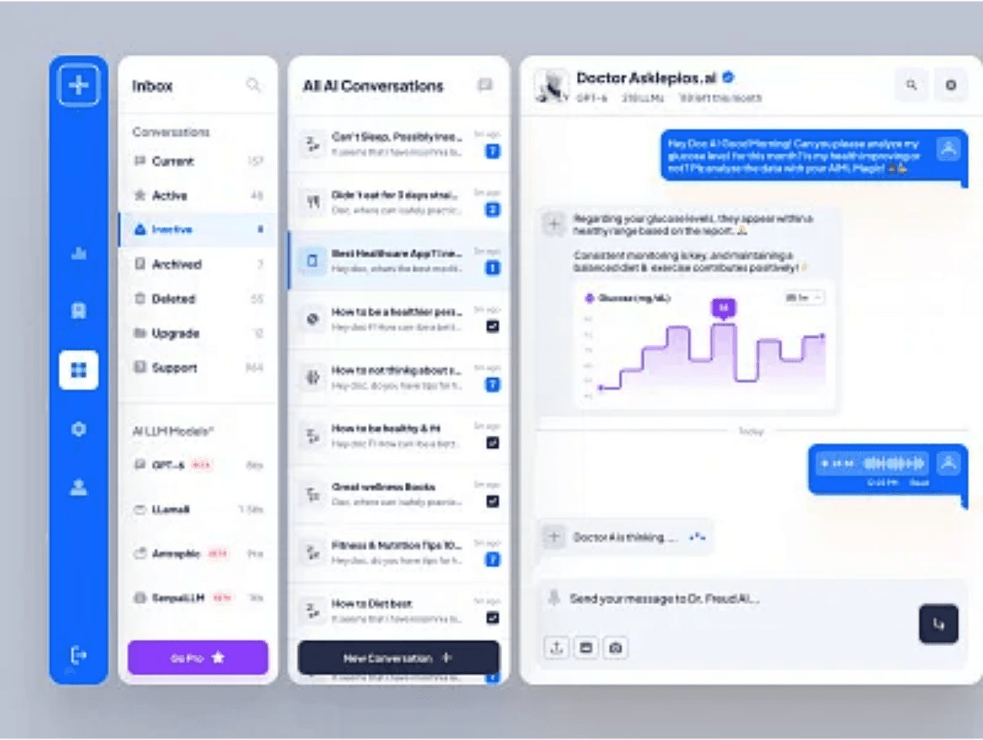
Seamless Communication
The Bonrix WhatsApp AI Chatbot
Revolutionize your business communication with a secure and efficient WhatsApp AI Dashboard for managing customer interactions.
✓
AI Dashboard:
Seamless, secure, and efficient management of WhatsApp business interactions
✓
24/7 Availability:
Instant responses and support around the clock
✓
Scalability:
Easily handle a high volume of customer inquiries
✓
Conversion Tracking:
Manage all WhatsApp chats and track conversions without code

Slide 6

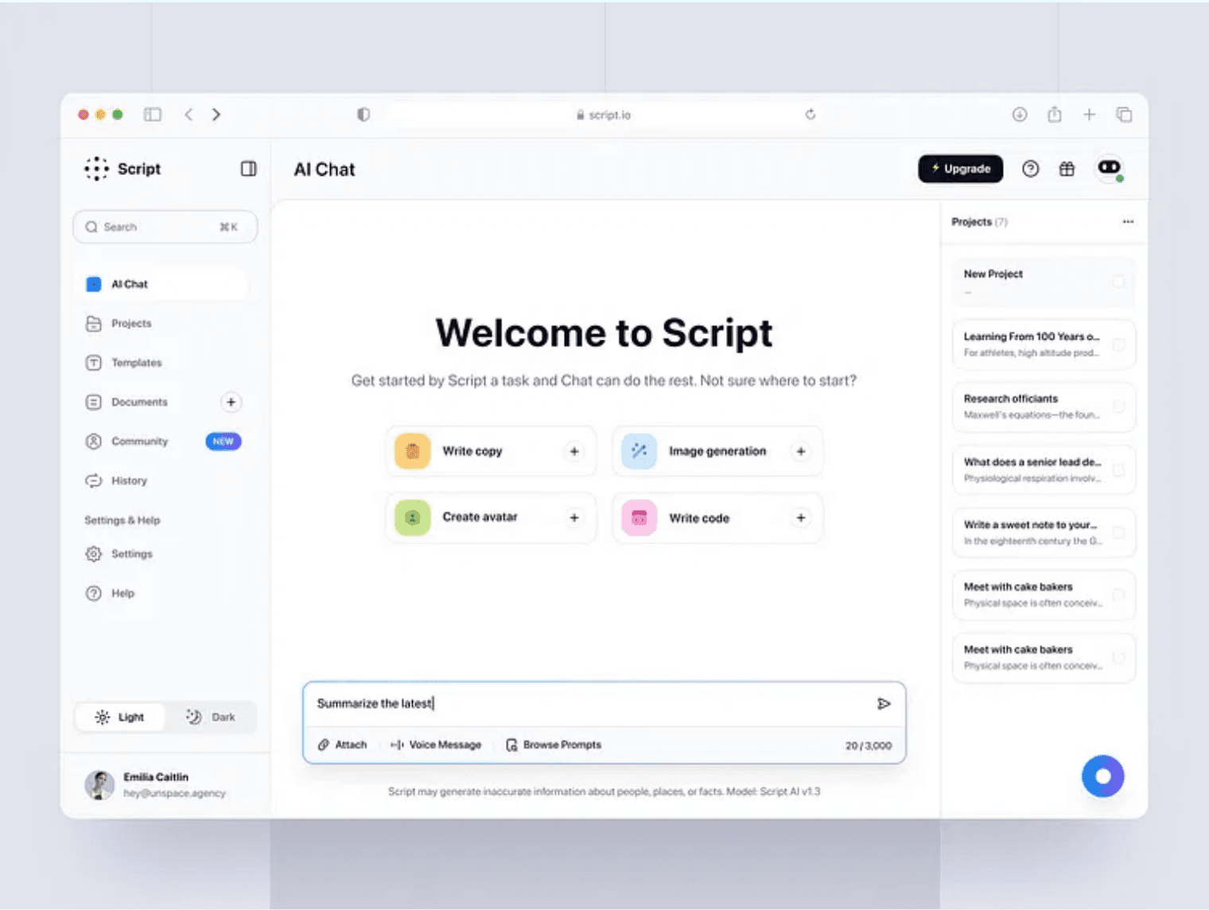
Redefining Digital Conversations
AI ChatBot for Websites
Transform your website from a static brochure into an intelligent, responsive digital platform that thinks, responds, and engages like a human.
✓
Beyond Automation
✓
Grounded in Content
Meaningful, personalized interactions that build genuine customer relationships
AI trained on your specific website content for accurate answers
✓
No-Code Dashboard
✓
Builds Trust
Easy setup and real-time analytics without technical complexity
Transparent, reliable responses that enhance brand credibility

Slide 7





Key Differentiators
Why Bonrix Stands Out
Real-World AI/ML
Continuous Innovation
Focus on solving practical business problems where traditional programming falls short.
Commitment to evolving with the latest AI advancements and market trends.
Security & Privacy
Comprehensive Suite
Utilizing federated learning for robust data protection and user privacy.
Solutions for e-commerce, WhatsApp, and website engagement in one platform.

Slide 8

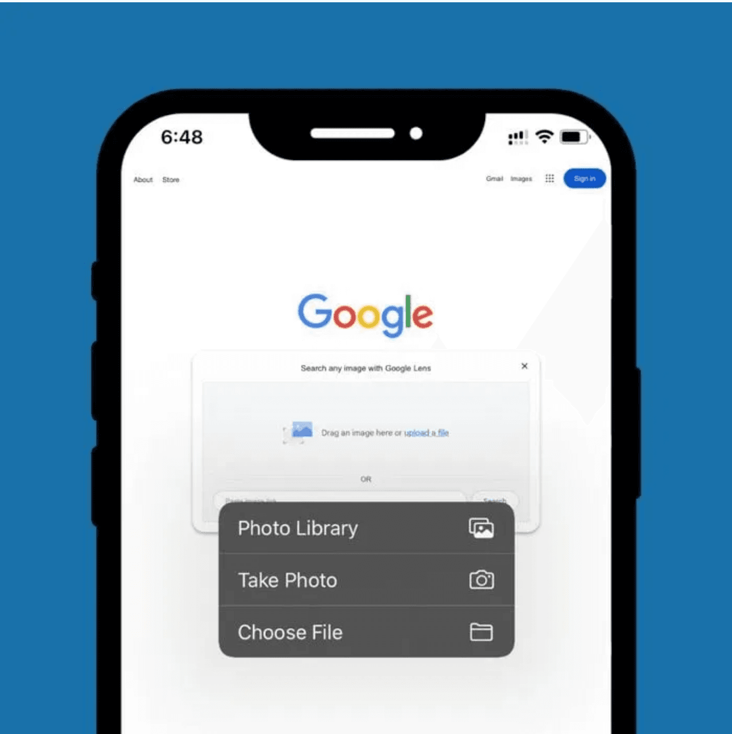
Use Case: Boosting E-commerce
How Image-to-Image Search Increases Customer Satisfaction and Conversion Rates
1
Scenario
Customer Uploads Photo
A customer finds an item they like and wants to find it in your catalog—but doesn't know what to search for.
2
Bonrix Solution
Image-to-Image Search
Our AI instantly finds the exact product or similar items in your catalog, eliminating keyword limitations.
3
Outcome
Reduced Friction & Higher Sales
Seamless product discovery, improved customer satisfaction, and increased conversion rates through engaging shopping experience.

Slide 9








Use Case: 24/7 Customer Service
Excellence Through Intelligent Automation
Scenario
Key Benefits
Query Outside Hours
A customer has an urgent question outside of your business hours and needs immediate assistance.
Instant Response
No waiting times—customers get answers immediately, 24/7
Bonrix Solution
Accuracy
Instant AI Response
AI trained on your content ensures precise and reliable answers
The AI Chatbot provides an immediate, accurate, and personalized response based on your company's content and knowledge base.
Scalability
Handle unlimited customer inquiries without additional staff
Cost Reduction
Outcome
Reduce support costs while improving customer satisfaction
Business Excellence
Lower operational costs, higher customer satisfaction scores, and improved lead qualification and conversion.

Slide 10




Ready to Transform Your Workflow?
Join thousands of businesses leveraging Bonrix AI.
Explore Our Solutions
Visit Bonrix.biz to discover AI-powered products tailored to your needs.
Request a Personalized Demo
See how Bonrix AI addresses your specific challenges.
Connect with Our Team
Contact us to discuss custom AI solutions for your organization.
The future of intelligent business is here. Let's build it together.

